Slide 1
Produce API .Net Core

Slide 2
ToDo
Adding another model based on given ERD

Slide 3
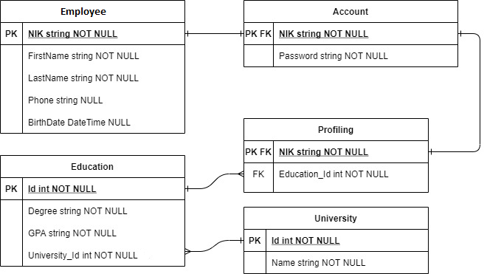
Add another model based on ERD below

Slide 4
You need to define each relation between the table in your MyContext file
To know how, let’s take a look on this link
One to One relationship
One to Many relationship
Many to Many relationship

Slide 5
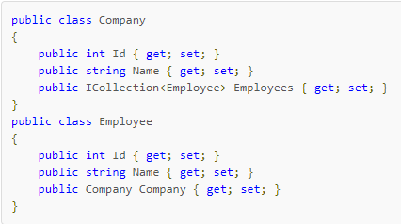
Attention!
Beware on when to use ICollection<Model> and which class to use it

Slide 6
Don’t forget to migrate your Model
Check your database then, is your table already added to your database?

